Slide 1

Dissipation Nation
Sabee Grewal, Matthew Hagan, Daniel Marti-Dafcik, Lucia Vilchez-Estevez

Slide 2
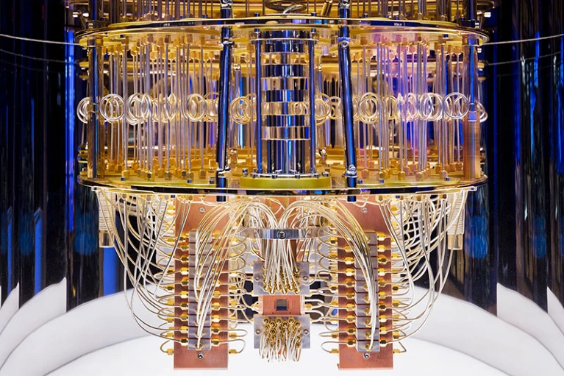
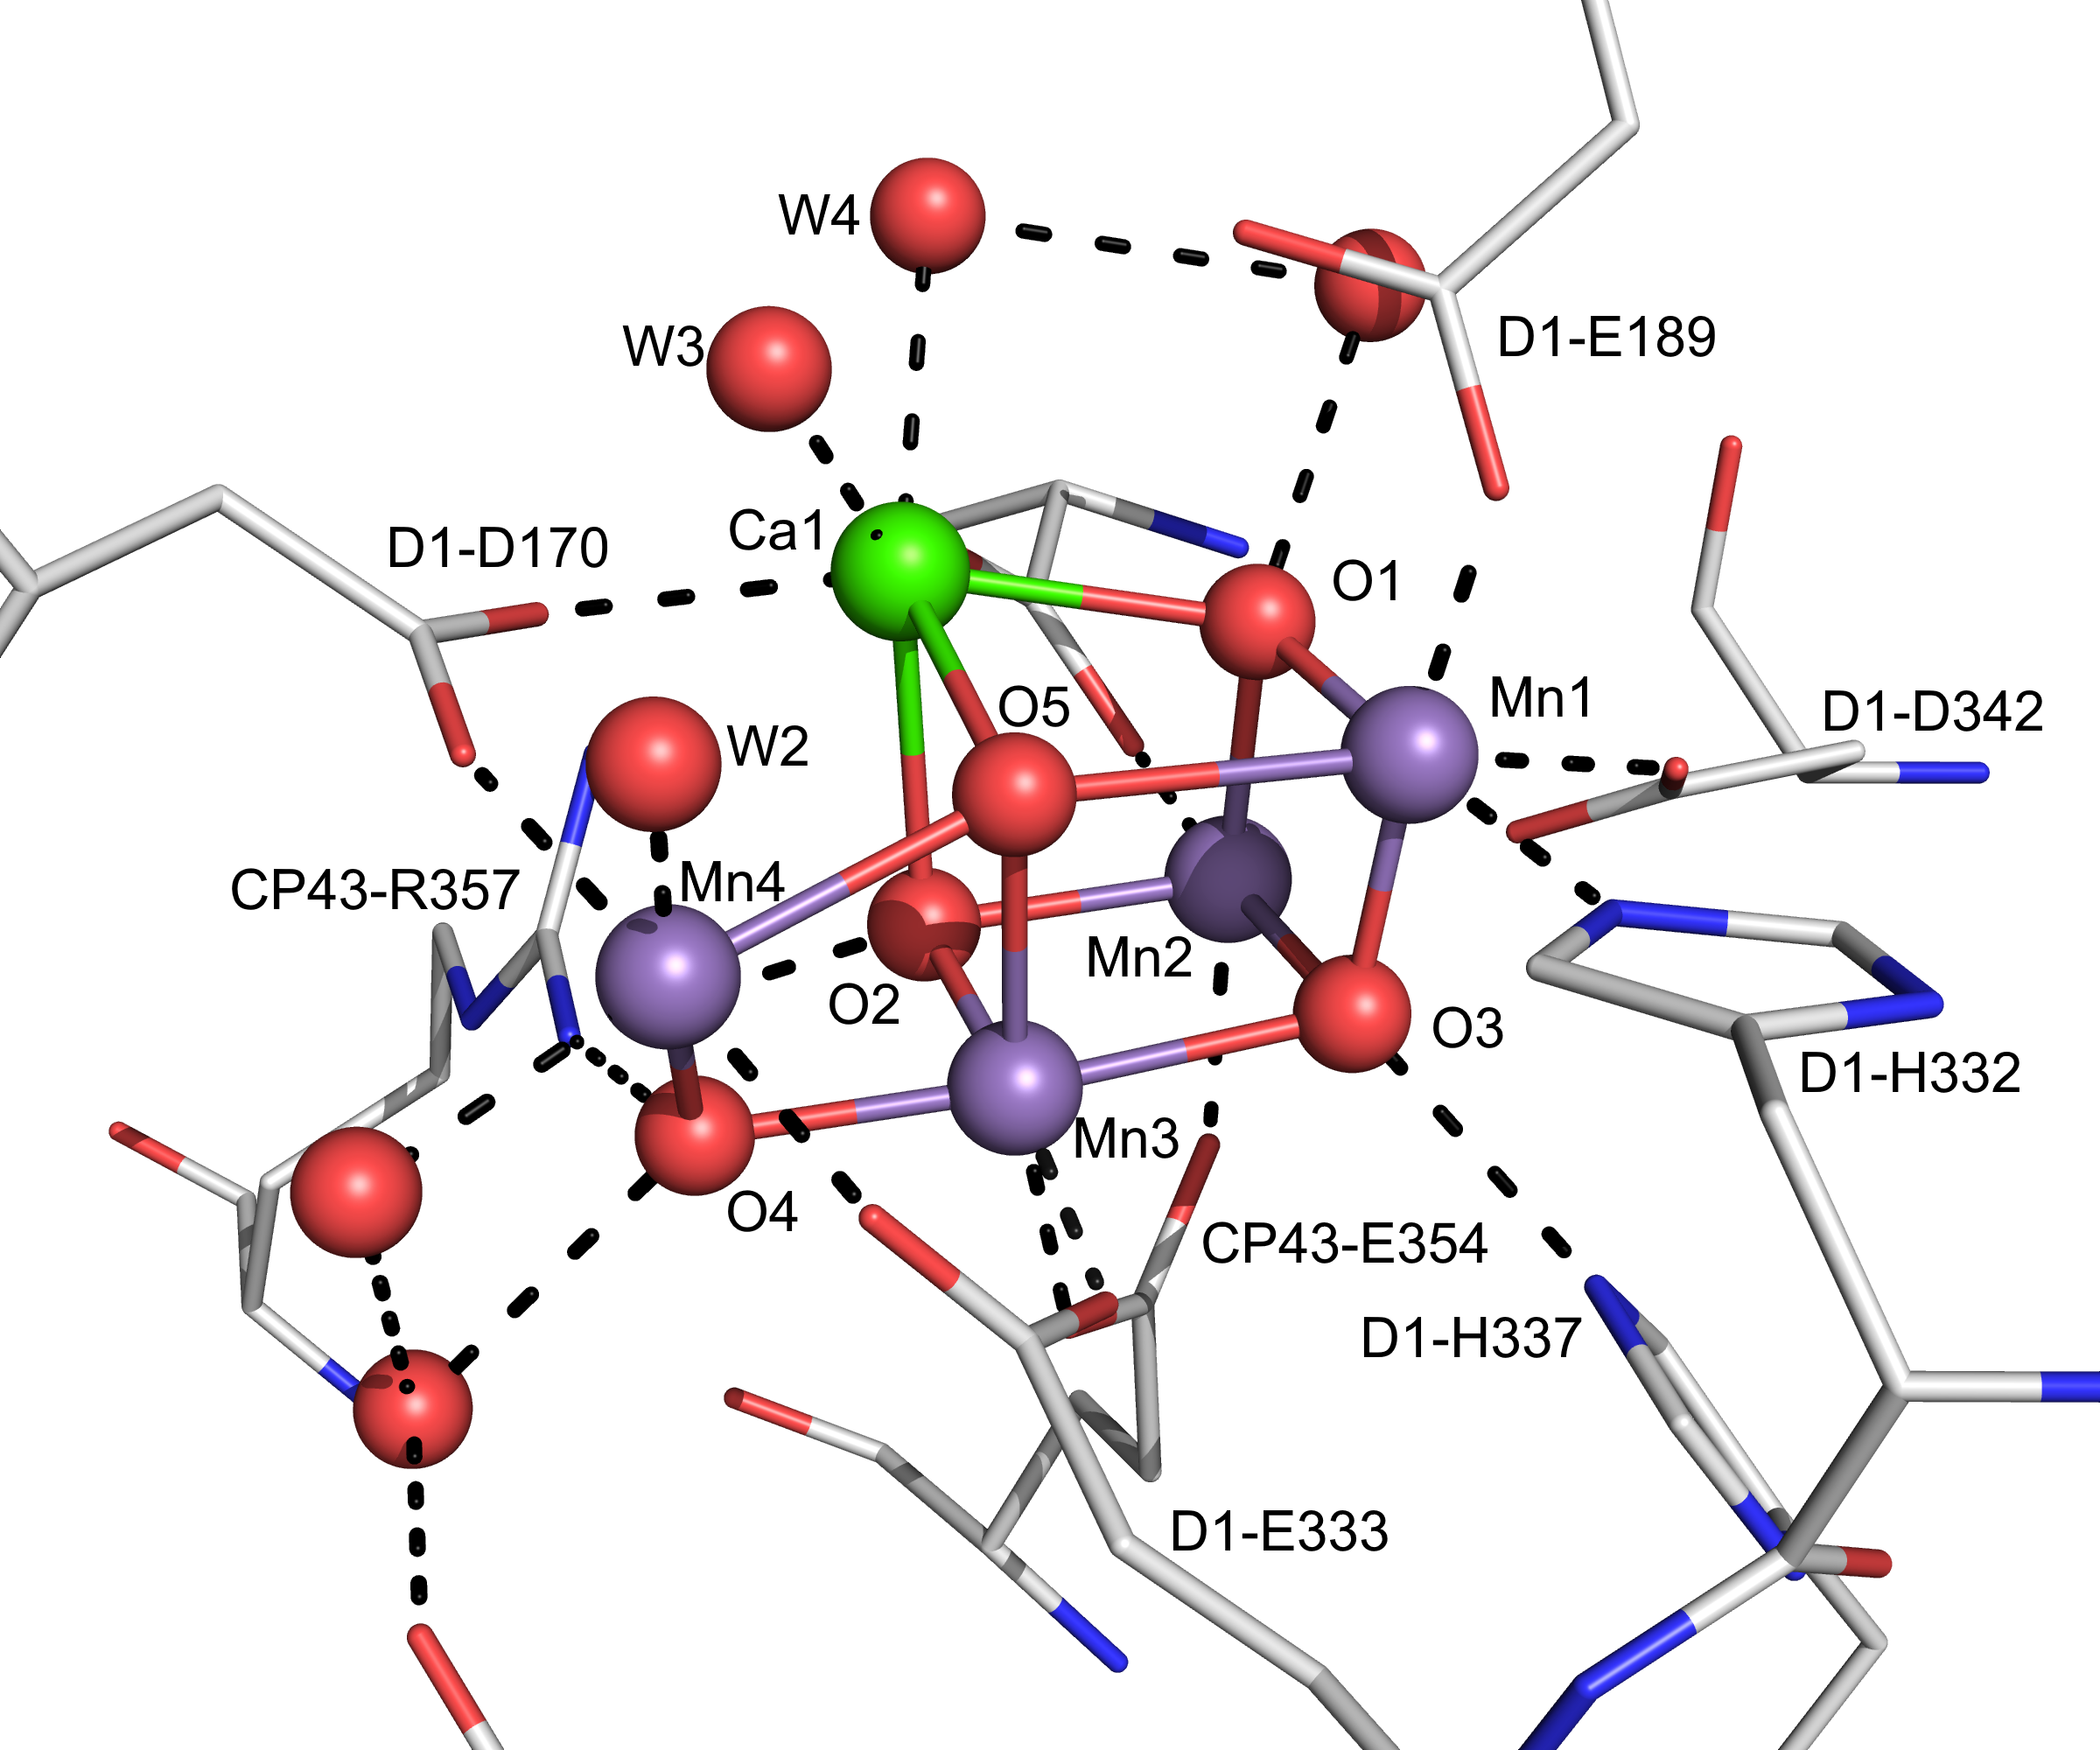
What is the Dissipative Quantum Eigensolver?
Algorithm to prepare a ground state due to T. Cubitt (arxiv:2303.11962)
H
ρ
Nature. 473 (7345): 55–60
Nature 599, 542 (2021)
Notes:
Input: a Hamiltonian
Output: a quantum state close to the true ground state

Slide 3
What is the Dissipative Quantum Eigensolver?
ρ = initial state
until (stop condition):
ρ, b = E(ρ)
if b:
Do some qubit resets
return ρ
ρ will be close to the true ground state!

Slide 4
What is the Dissipative Quantum Eigensolver?
ρ = initial state
until (stop condition):
ρ, b = E(ρ)
if b:
Do some qubit resets
return ρ
Approximate GS projection
ρ will be close to the true ground state!

Slide 5
Why DQE?
Scientifically important
Ground state preparation central in quantum chemistry and materials!
Enables computing important properties
Example: energy → reaction rates
Advantages of DQE
Provable guarantees
Noise resilient
Conceptually simple
Notes:
Most of the time, nature is in its ground state. Reason: thermal energy is much smaller than spectral gap

Slide 6
Why DQE?
A good fit for Triple Alpha!

Slide 7
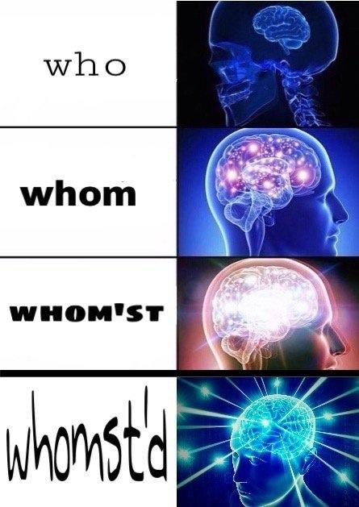
Why DQE? A good fit for Triple Alpha!
ρ = initial state
until (stop condition):
ρ, b = E(ρ)
if b:
Do some qubit resets
return ρ

Slide 8
Why DQE? A good fit for Triple Alpha!
Looping uses the Turing-completeness of Helium
ρ = initial state
until (stop condition):
ρ, b = E(ρ)
if b:
Do some qubit resets
return ρ

Slide 9
Why DQE? A good fit for Triple Alpha!
Looping uses the Turing-completeness of Helium
ρ = initial state
until (stop condition):
ρ, b = E(ρ)
if b:
Do some qubit resets
return ρ
}
Intermediate measurements! Complicated control of the quantum device made easy.

Slide 10
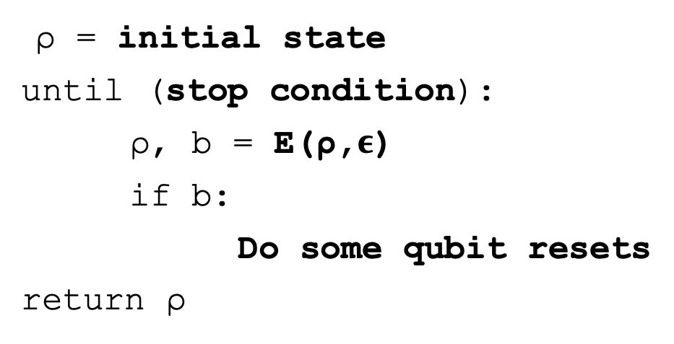
Why DQE? A good fit for Triple Alpha!
Looping uses the Turing-completeness of Helium
ρ = initial state
until (stop condition):
ρ, b = E(ρ,$ε$)
if b:
Do some qubit resets
return ρ
}
Intermediate measurements! Complicated control of the quantum device made easy.
Interesting parameters to play with! Implementation has practical importance!

Slide 11
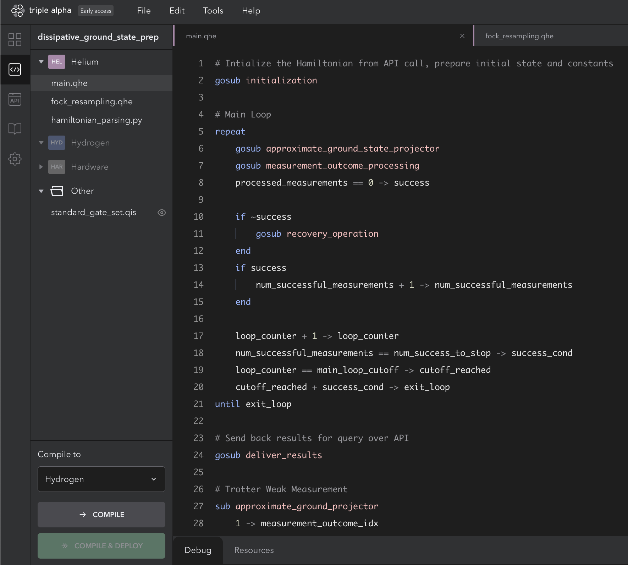
What did we do?
~ 200 lines of Helium code! And Python client code!
Deployed as an API!

Slide 12
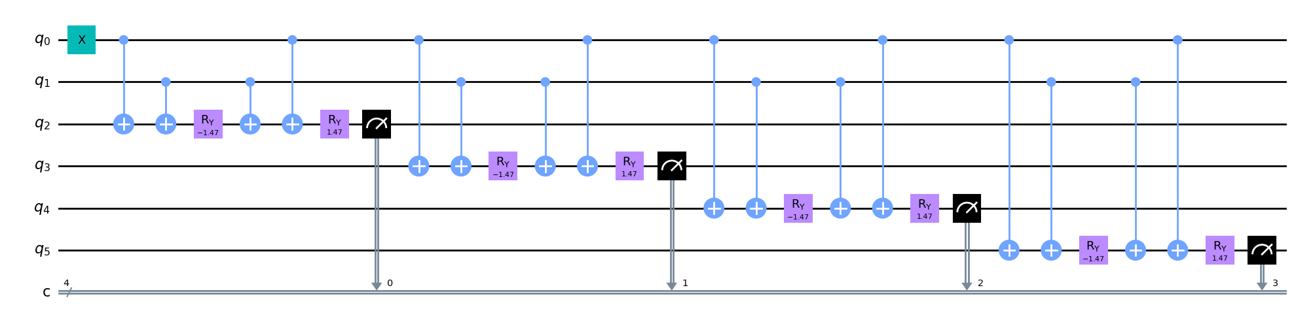
What did we do?
Built down to IBM circuit :)
H → U = approximate GS projector

Slide 13
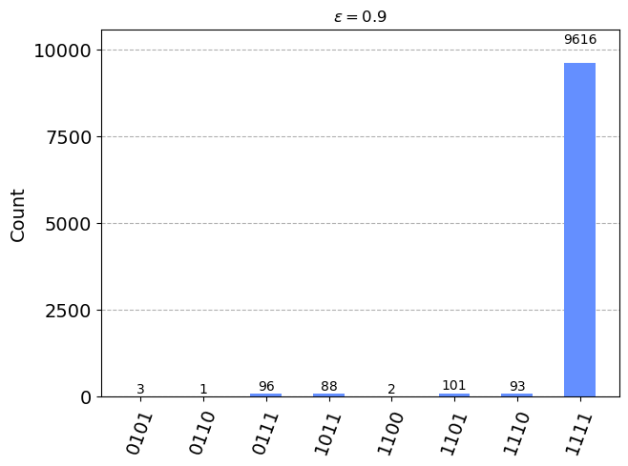


What did we do?
$$ε=0.9$$
$$|GS>$$

Slide 14
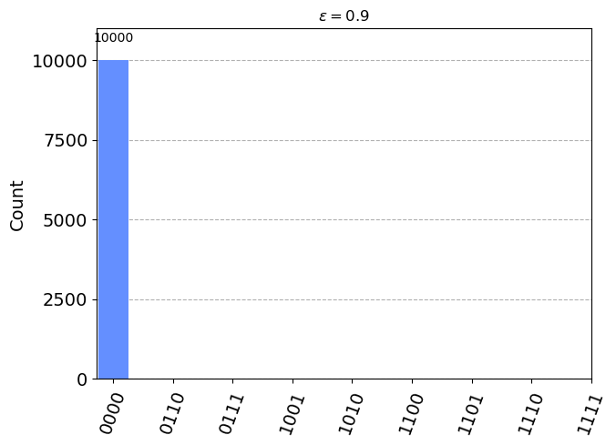


What did we do?
$$ε=0.9$$
$$ε=0.9$$
$$|GS>$$
$$|{GS}^{⊥}>$$

Slide 15
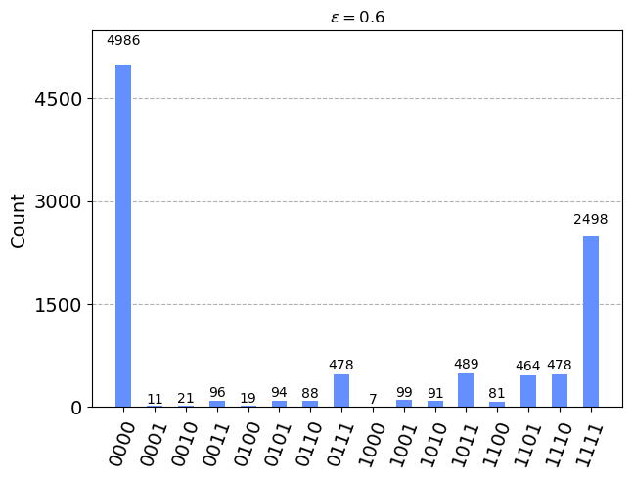
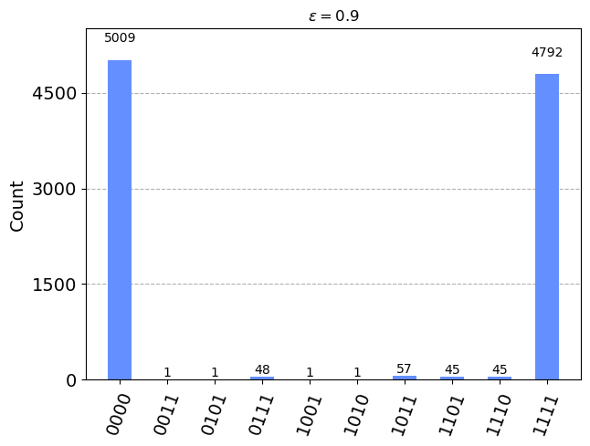
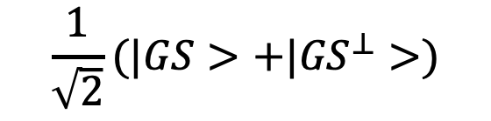


What did we do?
$$\frac{1}{\sqrt{2}}(|GS>+|{GS}^{⊥}>)$$
$$ε=0.6$$
$$ε=0.9$$
Decreasing $ε$ makes the projector more gentle

Slide 16
Improvements to Triple Alpha
Nondemolition measurements
Client libraries that abstract away curl request.
More expressive language features:
if expression rather than if int
increment i from A to B
Local IDE and local compiler

Slide 17
Future Work (at Bali next year?!)
Simulate DQE on H_{n} chain
Different instantiations of DQE:
Dependence on initial state
Resampling
Parameter scheduling

Slide 18

Future Work (at Bali next year?!)
Thank you, Horizon,
for the amazing experience!
Simulate DQE on H_{n} chain
Different instantiations of DQE:
Dependence on initial state
Resampling
Parameter scheduling

Slide 19
What is the Dissipative Quantum Eigensolver?
Alg to prepare ground states using a “stopped process”. Apply Approximate Ground State Projectors (AGSP) until you get n successes
Quantum While Loop
Conditional exit based on mid-circuit measurements
Ground states are incredibly useful
Most molecules live in ground state
Useful for SDP speedups
Theoretically: encode solutions to computations in ground states
Dissipative ground state preparation and the Dissipative Quantum Eigensolver - Toby Cubitt - arXiv:2303.11962

Slide 20
Why DQE? Scientifically important.
Ground state preparation is important!
Most molecules live in their ground state, because the spectral gap (E1 - E0) is much larger than thermal energy. Access to the ground state therefore enables computing important properties, including ground state energy
High accuracy is required: Relative energies between two molecular structures are crucial to predicting chemical processes: reaction rates depend exponentially on the energy difference between reactants and transition states
Advantages of the algorithm (versus others)
No guarantees of when exact ground state has been prepared
Noise

Slide 21
What did we do?
Built down to IBM circuit :)

